Slide 1
Lecture 05: Assembly Language Programming (2)

Slide 2
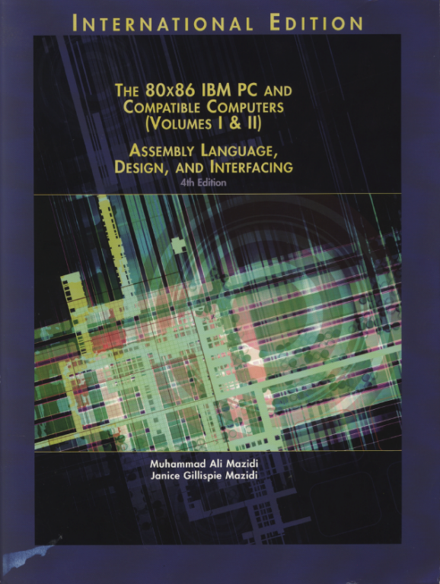
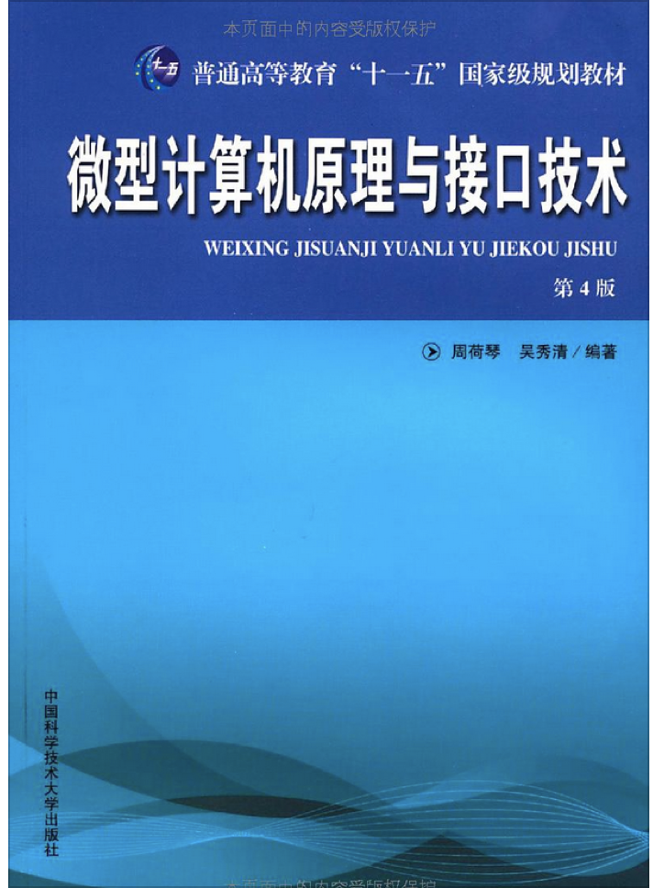
Reference Book:
The 80x86 IBM PC and Compatible Computers
Chapter 3 Arithmetic & Logic Instructions and Programs
Chapter 6 Signed Numbers, Strings, and Tables
微型计算机原理与接口技术（第四版）
第4章 汇编语言程序设计

Slide 3
Arithmetic Instructions
Addition
Subtraction
Multiplication
Division

Slide 4
Unsigned Addition
ADD dest, src ;dest = dest + src
Dest can be a register or in memory
Src can be a register, in memory or an immediate
No mem-to-mem operations in 80X86
Change ZF, SF, AF, CF, OF, PF
ADC dest, src ;dest = dest + src +CF
For multi-byte numbers
If there is a carry from last addition, adds 1 to the result

Slide 5
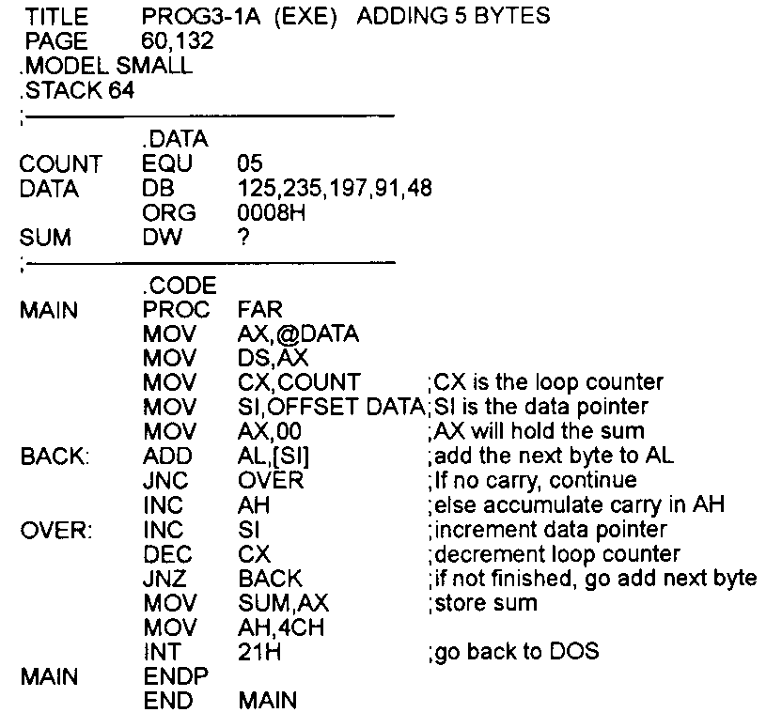
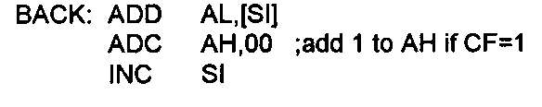
Addition Example of Individual Bytes
Draw the layout of the data segment in memory
What’s this for?

Slide 6
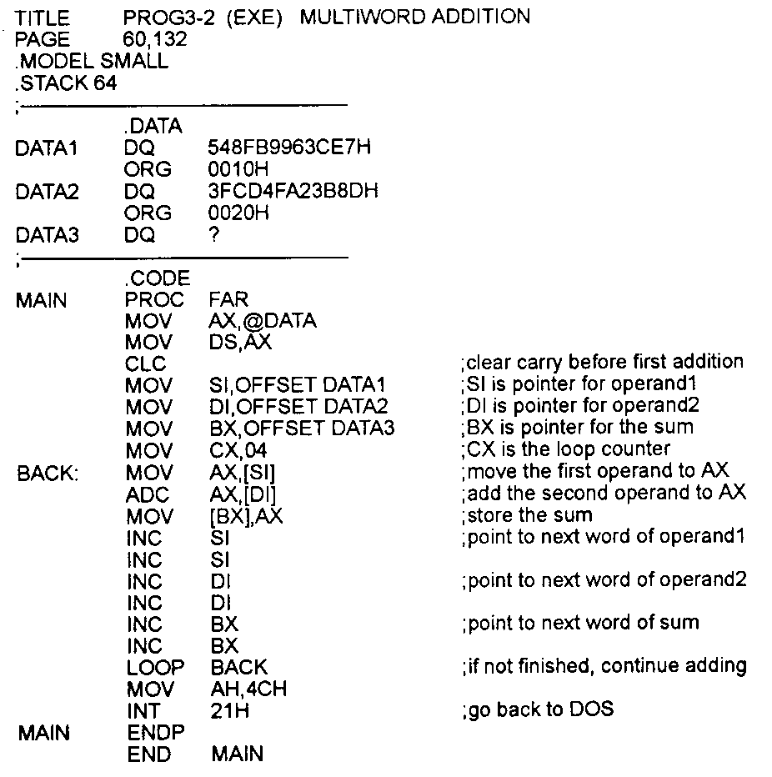
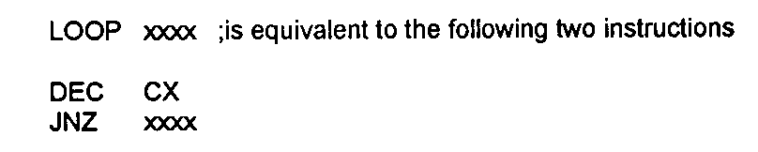
Addition Example of Multi-byte Nums

Slide 7
Unsigned Subtraction
SUB dest, src ;dest = dest - src
Dest can be a register or in memory
Src can be a register, in memory or an immediate
No mem-to-mem operations in 80X86
Change ZF, SF, AF, CF, OF, PF
SBB dest, src ;dest = dest - src – CF
For multi-byte numbers
If there is a borrow from last subtraction, subtracts 1 from the result

Slide 8
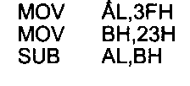

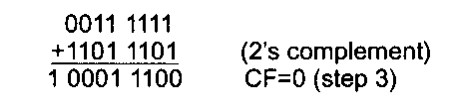


Subtraction Example of Individual Bytes
CPU carries out
take the 2’s complement of the src
add it to the dest
invert the carry
After these three steps, if
CF = 0: positive result;
CF = 1: negative result, left in 2’s complement
Magnitude: NOT + INC (if a programmer wants the magnitude)

Slide 9
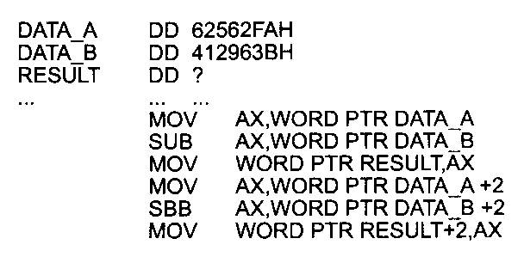



Subtraction Example of Multi-byte Nums

Slide 10
Unsigned Multiplication
MUL operand
byte X byte:
One implicit operand is AL, the other is the operand, result is stored in AX
word X word:
One implicit operand is AX, the other is the operand, result is stored in DX & AX
word X byte:
AL hold the byte, AH = 0, the word is the operand, result is stored in DX & AX;

Slide 11
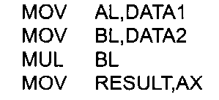
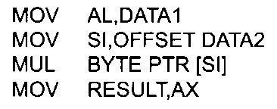
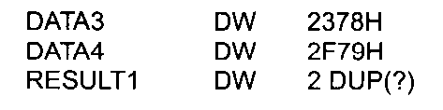
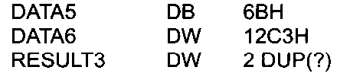
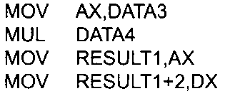
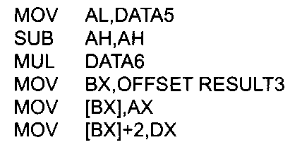
Unsigned Multiplication Example

Slide 12
Unsigned Division
DIV denominator
Denominator cannot be zero
Quotient cannot be too large for the assigned register
byte / byte:
Numerator in AL, clear AH; quotient is in AL, remainder in AH
word / word:
Numerator in AX, clear DX; ; quotient is in AX, remainder in DX
word / byte:
Numerator in AX; quotient is in AL (max 0FFH), remainder in AH
double-word / word:
Numerator in DX, AX; quotient is in AX (max 0FFFFH), remainder in DX
Denominator can be in a register or in memory

Slide 13
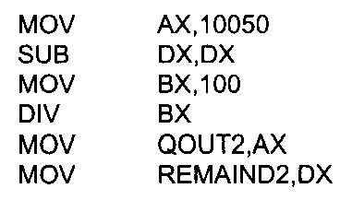
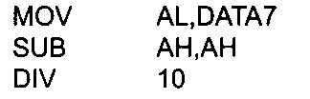
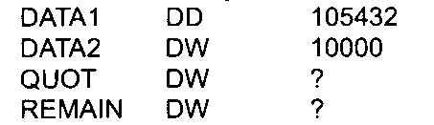
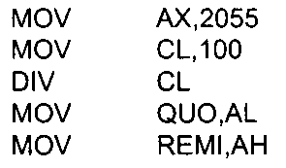
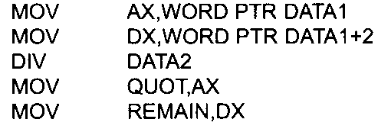
Unsigned Division Example

Slide 14
Logic Instructions
AND
OR
XOR
NOT
Logical SHIFT
ROTATE
COMPARE

Slide 15
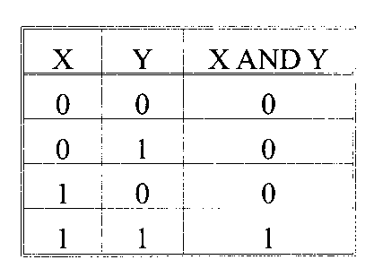
AND
AND dest, src
Bit-wise logic
dest can be a register or in memory; src can be a register, in memory, or immediate

Slide 16
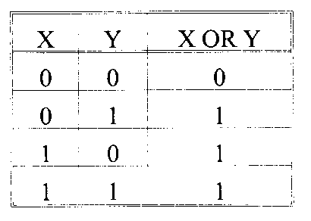
OR
OR dest, src
Bit-wise logic
dest can be a register or in memory; src can be a register, in memory, or immediate

Slide 17
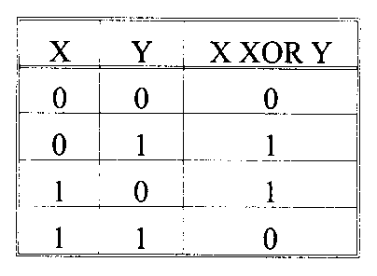
XOR
XOR dest, src
Bit-wise logic
dest can be a register or in memory; src can be a register, in memory, or immediate

Slide 18
NOT
NOT operand
Bit-wise logic
Operand can be a register or in memory
X NOT X
-------------------------------------------
1 0
0 1

Slide 19
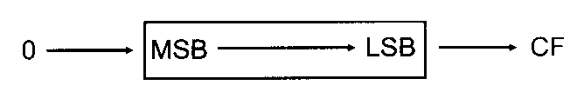
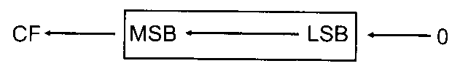
Logical SHIFT
SHR dest, times
dest can be a register or in memory
0->MSB->…->LSB->CF
Times = 1:
SHR xx, 1
Times >1:
MOV CL, times
SHR xx, CL
SHL dest, times
All the same except in reverse direction
只能CL

Slide 20
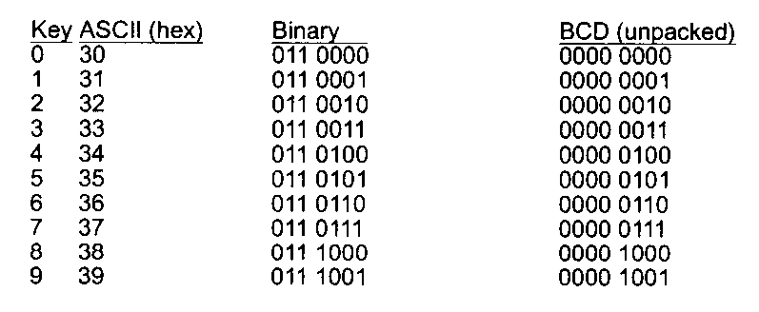
Example: BCD & ASCII Numbers Conversion
BCD: Binary Coded Decimal
Digits 0~9 in binary representation
Unpacked, packed
ASCII
Code for all characters that you can read or write
Digit characters ‘0’~’9’

Slide 21
ASCII -> Unpacked BCD Conversion
Simply remove the higher 4 bits “0011”
E.g.,
asc DB ‘3’
unpack DB ?
-------------------------
MOV AH, asc
AND AH, 0Fh
MOV unpack, AH

Slide 22
ASCII -> Packed BCD Conversion
First convert ASCII to unpacked BCD
Then, combine two unpacked into one packed
E.g., asc DB ‘23’
unpack DB ?
-------------------------
MOV AH, asc
MOV AL, asc+1
AND AX, 0F0Fh
MOV CL, 4
SHL AH, CL
OR AH, AL
MOV unpack, AH

Slide 23
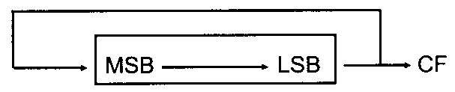
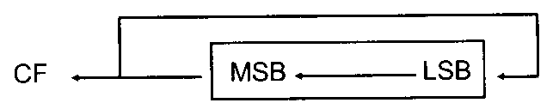
ROTATE
ROR dest, times
dest can be a register, in memory
Times = 1:
ROR xx, 1
Times >1:
MOV CL, times
ROR xx, CL
ROL dest, times
All the same except in reverse direction

Slide 24
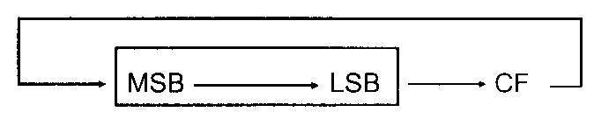
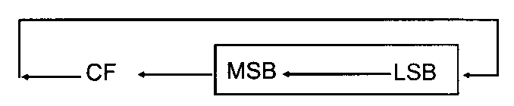
ROTATE Cont.
RCR dest, times
dest can be a register, in memory
Times = 1:
RCR xx, 1
Times >1:
MCV CL, times
RCR xx, CL
RCL dest, times
All the same except in reverse direction

Slide 25
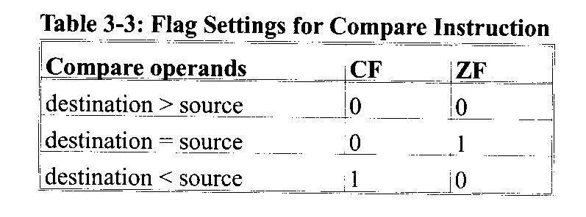
COMPARE of Unsigned Numbers
CMP dest, src
Flags affected as (dest – src) but operands remain unchanged
E.g., CMP AL, 23
JA lable1 ; jump if above, CF = ZF = 0

Slide 26
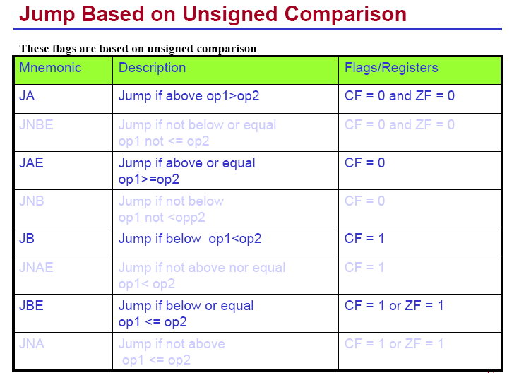

Slide 27
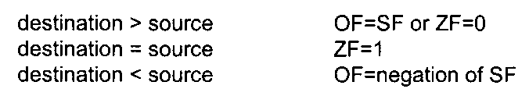
COMPARE of Signed Numbers
CMP dest, src
Same instruction as the unsigned case
but different understanding about the numbers and therefore different flags checked

Slide 28
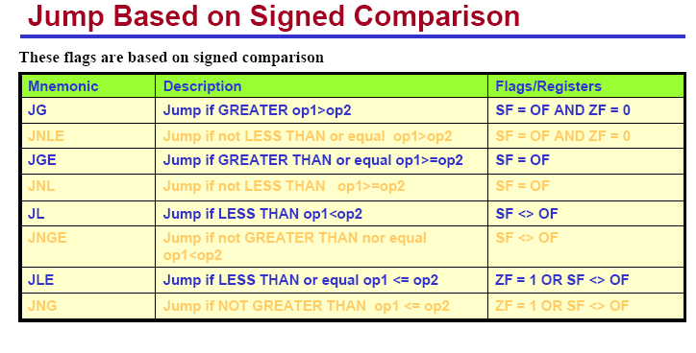

Slide 29
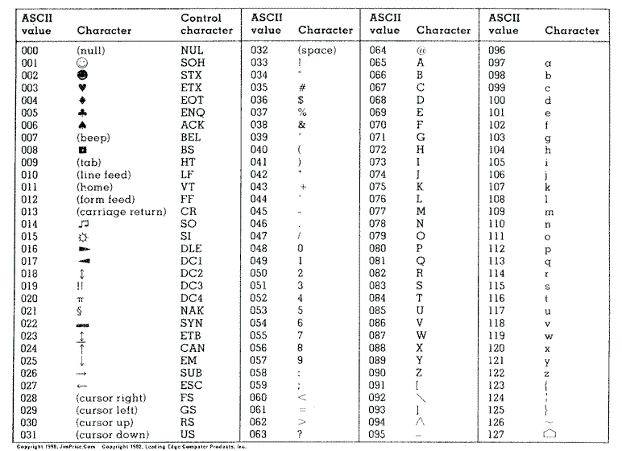
Quiz
Given the ASCII table, write an algorithm to convert lowercase letters in a string into uppercase letters and implement your algorithm using 86 assembly language.

Slide 30
Answer to Quiz

Slide 31
XLAT Instruction & Look-up Tables
Self-learning
pp. 189 in Chapter 6

